Slide 1
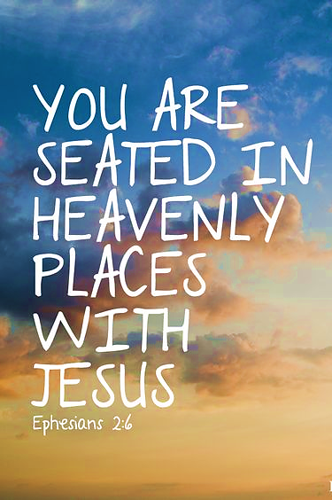
Ephesians 2.6
Yahweh raised us up with the Messiah Yeshua and seated us together with Him in the heavenly realms.

Slide 2
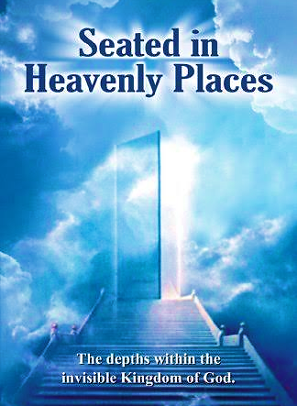
Declaration
Father, what You have said You will do and it is only by Your hand that we can declare Your glorious work of transformation, elevating us to sit with our Messiah and King.

Slide 3
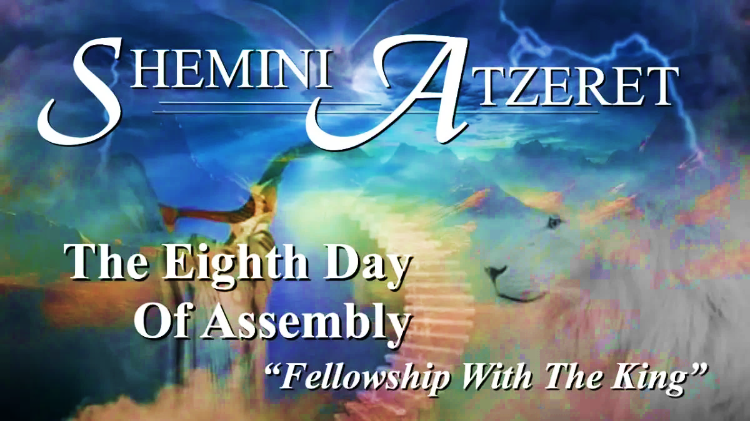
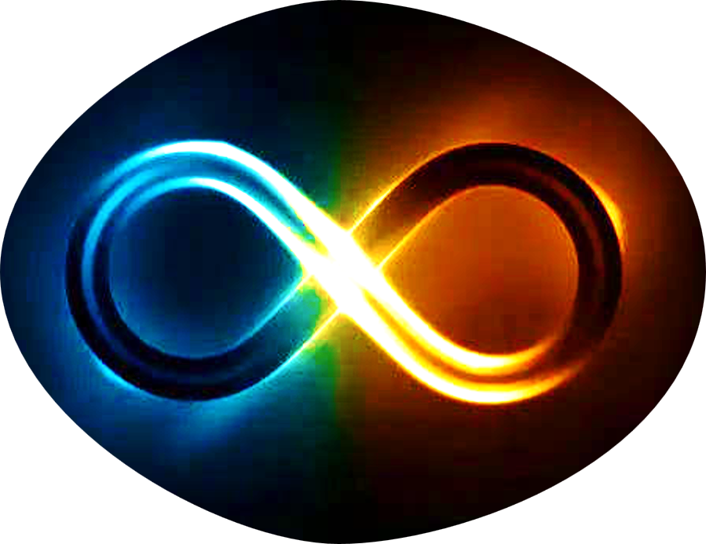
Leviticus 23.36b
“…on the eighth day you are to have a holy convocation and bring an offering made by fire to Adonai; it is a day of public assembly; do not do any kind of ordinary work.”

Slide 4

Shemini Atzeret
Atzeret literally means the keeping, the maintaining, the holding back, the recovery and the retaining. So, this day we rejoice because we see into our eternity and walk as those who are without limitations in Yah.
Focusing on all the good that was done for Yah and for His purposes. Every work of faith, of love, purity, of redemption, of salvation all that was birth in YHVH.
As children of the eighth day, we have the power to leave the old life, to transcend this creation, overcome all limitation to live in the realm of the heavenly.
The gathering (Atzeret) speaks of the end of time; the number eight transcends the creation; it breaks out of time. When finite yields to the infinite-meaning limitations are no more!
The day foreshadows the passing away of heaven and earth, the ending of the present order and the beginning of eternity.

Slide 5
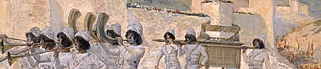
Yom Teruah
Yah’s people will gather up to Him. This wake-up call will announce the beginning of our King’s reign. [1 Cor. 15.52] The kingdom of this world will become the kingdom of the Lord.
So, let us live this day in confidence and hope, looking to the future, knowing He is already there, Lord of the future, awaiting us to arrive.
Yom Teruah take place at the end of the sacred Hebrew year-the mystery focus is at the end (closing of an age).
The trumpets announce the coming of kings and kingdom, and the approaching armies. i.e., Joshua chaps. 3-6
Therefore, when the trumpet sounds…

Slide 6
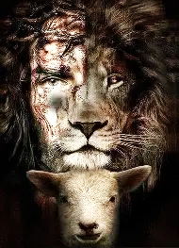
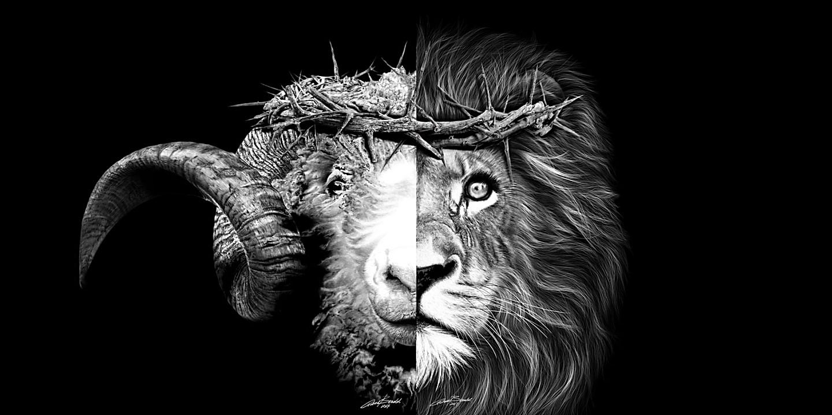
Yom Kippur - Qorban
(H7133) Sacrifice is a word of closeness, intimacy, not cruelty. Yahweh’s gift is about connection.
Isa 53.10 says Yeshua was given by the Father in love to remove the barrier of fear between us and God.
Yahweh’s highest expression of love is found in Yeshua’s death; not as a slaughtered hostage appeasing His wrath, but the fullest embodiment of self-giving love-to draw us near.
Our Messiah did not die to change God’s disposition toward us. He died to reveal God’s eternal character of love.
Sacrifice is about relationship Ro 12.1. We are to walk in that same love in life in our daily acts.

Slide 7
Yom Kippur - Semikhah
Each of us must preform a “Semikhah”. Placing our hands on Yeshua’s head by laying our life upon His life, our burdens, our fears, our shame, cares, joining every part of our life to the sacrifice of love. Then the two lives can be lived as one.

Slide 8
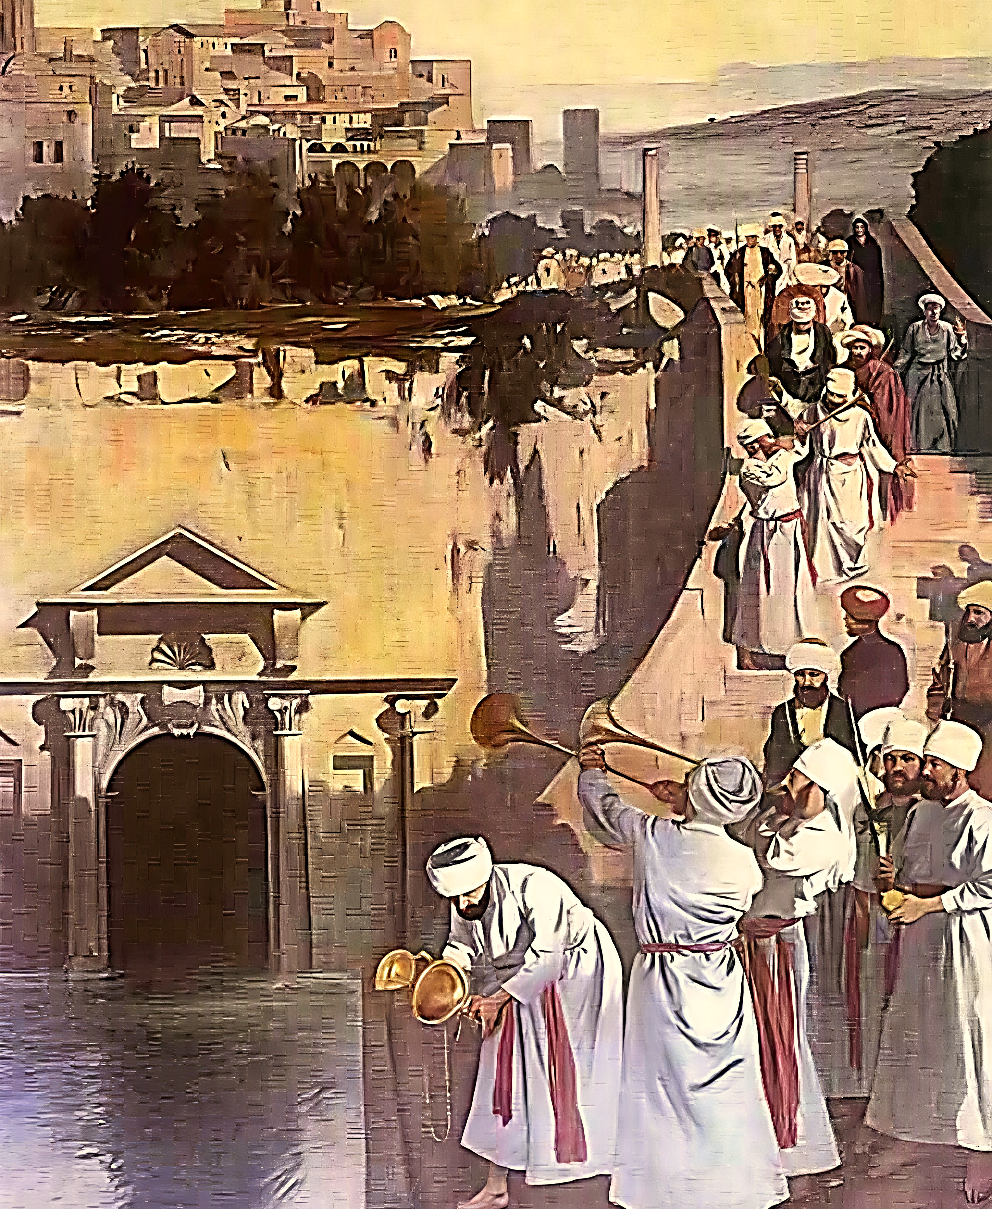
Sukkot - Water Ceremony
Each morning, of the days of Sukkot a priest, accompanied by a procession of Levites playing instruments, went to the Pool of Siloam to draw water in a golden pitcher-returning to the Temple via the Watergate. Then circling the altar, the priest poured the water into silver basins at the altar’s base.
The libation of water and wine were poured simultaneously into the altar, symbolizing both physical and spiritual sustenance.
John 7.37-38 Yeshua gives and invitation on the 8th day. (Isaiah 12.2-4; 44.3-5)
John chap.4 esp. v.14

Slide 9
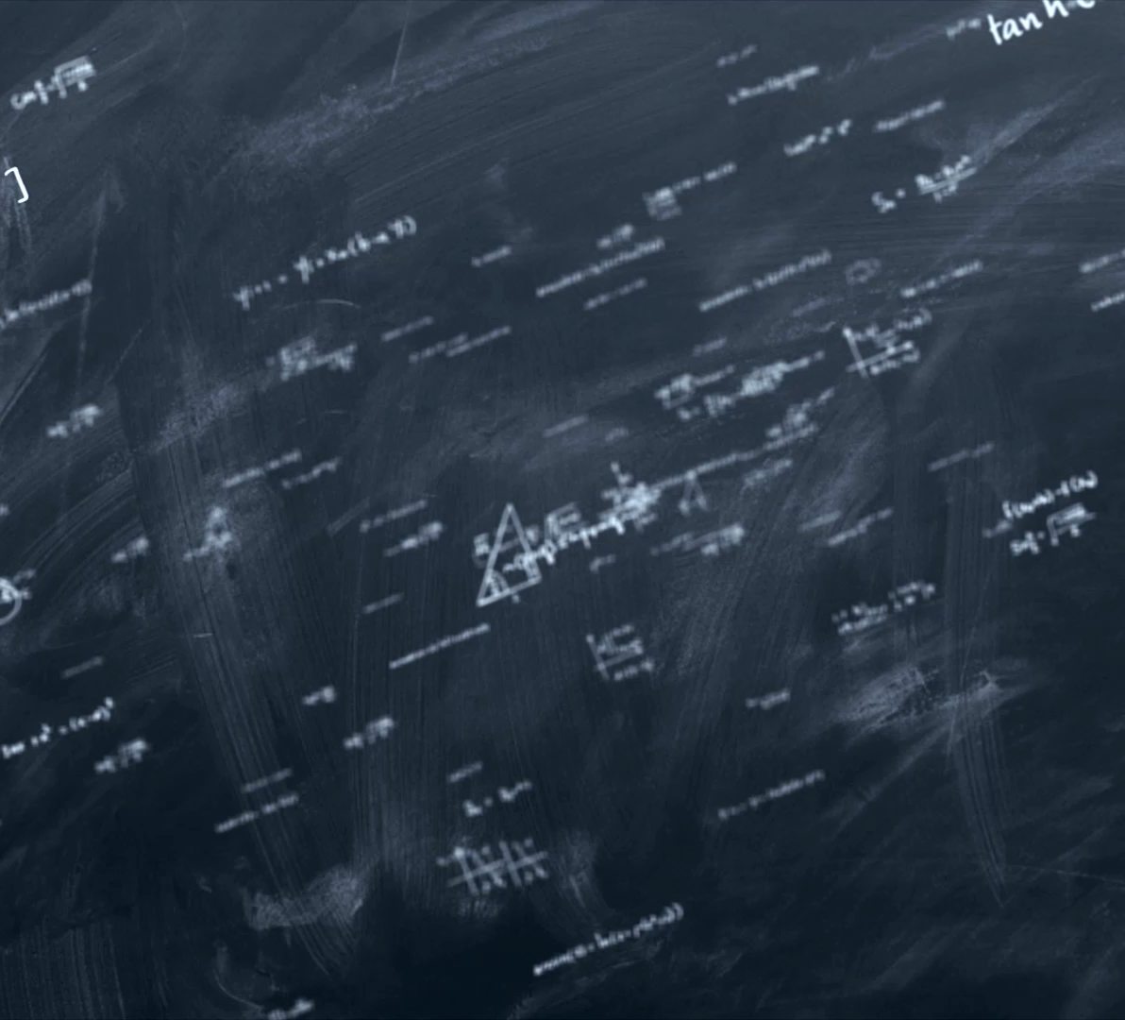
The Finite Yields to the Infinite!
Shemini Atzeret 5787

Slide 10
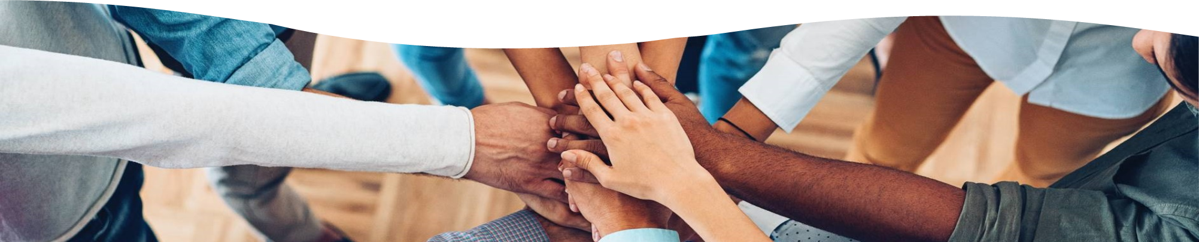
Children of the Eighth Day

