Slide 1

5787 Cheshvan 20

Slide 2
Ephesians 4.4-6
“Av Lakol, Father of us all!”
Decree & Declare
Yahweh, You are the Father of us all. By Your Spirit, You are producing oneness of Spirit in our lives. We are one with You, one with Messiah and we walk in unity in the Body of Messiah.

Slide 3
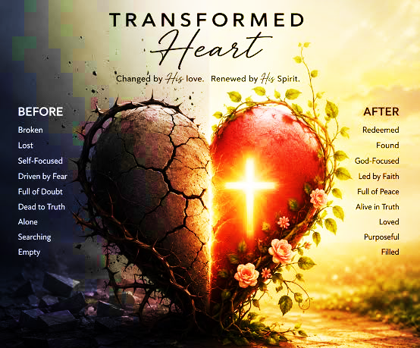
Psalm 111

Slide 4

Eziekiel 34.2-12 & Luke 12.42-46
  Priest of Ecuador was crushed under fallen idol statue resembling the crucifixion; was accused of imprisoning children and embezzling money from parishioners.
Doctrines of demons 1Timothy 4.1
  Ohio pastor embraces polygamy, announces second wife.

Slide 5


Pentagon
Warning!
US Pentagon prepares for America’s ‘doomsday’: Military now bracing for 90 days of isolation. Crisis-proof your nest egg.
FORTRESS America, 90-day goal covers essential needs, including electricity, water, fuel and communications was announced September 30^{th.}
Every nation has joined the call to prepare.

Slide 6
Father of Glory (Avi Hakavod)
This attribute of the Lord emphasizes His majesty, authority and power emanating from His glorious presence.
Paul’s prayer focuses on going beyond a superficial understanding of Messiah in the natural realm, into a new realm of the revelation knowledge, obtaining a deep, personal, intimate knowledge of Messiah.
As we continue to look upon the Lord, the Ruach will transform us into His image whereby His glory is manifested.
Paul emphases this in his letter to the Corinthians (2 Cor 3.18) saying as they continued to keep their eyes on Yeshua, they would go from glory to glory, by the power of His Spirit.

Slide 7
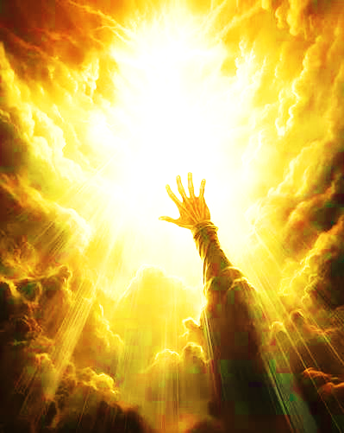
Father of Glory (Avi Hakavod)
Chanukah/Hanukkah
December 5th Shabbat Service
After Shabbat – Oneg provided by the ministry
Return for Chanukah celebration – Theme “Live as a candle in the darkness that contrast its surroundings”
After – Dessert and games and challenges
December 6th – 12th @ 6:30 pm Teaching (minor prophets) each night on Conference Call Line. (use cell or download app on laptop to view candle lighting and teaching)

Slide 8

Review “I am…. a dwelling place of Ruach”
Eat from Spiritual food of the Lord
John 6.60-66

Slide 9
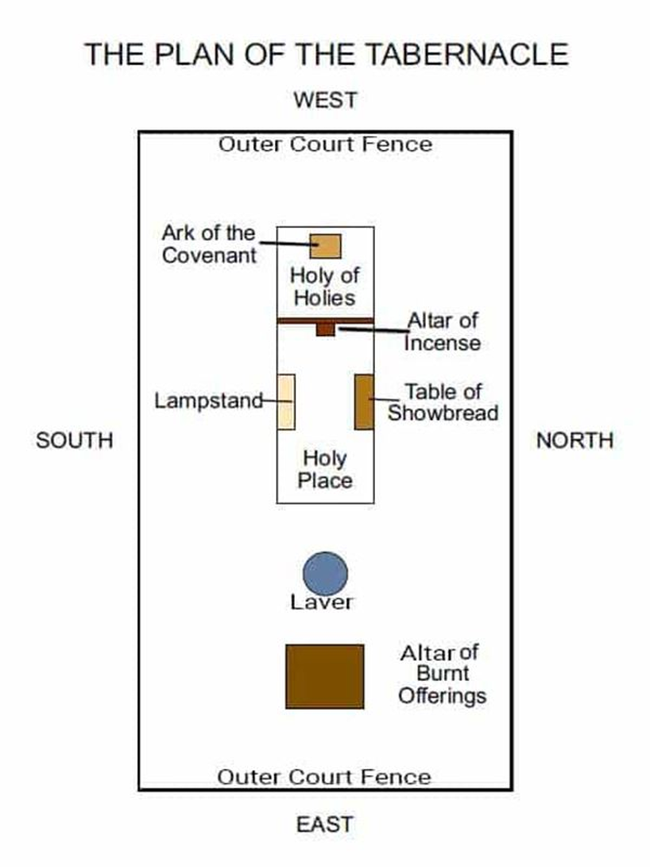
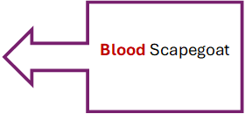
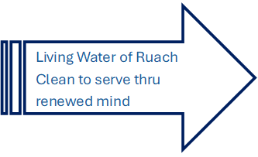
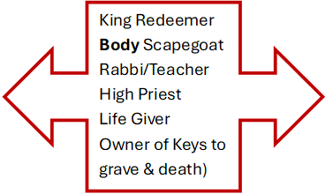

Slide 10
Feature | Altar of Sacrifice | Mercy Seat
Location | Courtyard of the tabernacle/temple | Inside the Holy of Holies, on the Ark of the Covenant
Central Role | Place where sacrifices were offered | Place where provision of atonement was made through blood
Presentation made | Daily sacrifices | Once a year (Day of Atonement)
Symbolism | Meeting place for worship and atonement | Hashem’s presence, mercy
Notes:
The altar and the mercy seat were linked:
The altar provided the sacrificial blood, which was then brought into the Holy of Holies and sprinkled on the mercy seat.
Together they illustrated that atonement required both the offering of a sacrifice and the application of that sacrifice’s blood before Yahweh’s presence.
In the renewed covenant, Messiah is presented as the ultimate “mercy seat”— fulfilling the original covenant system

Slide 11
Altar of Sacrifice
The tabernacle furniture was the mechanism for restoring the fallout of human corruption and folly.
Therefore, the first place a “worshipper” would encounter through the door was the altar. The perfect square, four corners (meaning the gospel is nondiscriminatory; whosoever will), is where the blood sacrifices under heat of fire was offered unto God for atonement.
If the courtyard had been set up with no altar or priest, it would convey that one could approach Yahweh’s presence without a mediator.
For several Shabbat’s we have addressed all that was accomplished by Yeshua at the altar-its rituals were called “shadow of good things to come”; the reality of salvation that was obtained by Messiah.
It was here that Israel & our brokenness must be dealt with before heaven and earth could be united.

Slide 12
HOMEWORK
The Hebrew word for praise is Halal (root of Hallelujah). However, there are several words that describe praise, see below. Obtain the definition for each word accompanied by one Scripture. Also give the definition for the word worship "Shachah".
Zamar: With instruments
Tehillah: Exaltation in words
Shabach: Raised voices
Yadah: Gratitude (3034) in battle, Ex 17
Todah or Towdah: Thanksgiving
Shachah (worship): Bow down, to kneel to prostrate oneself (heart posture) in life surrender
Not emotional crescendo of musical excellence, but an act of giving.
Worship is tethered to sacrifice.
Now explain the difference between praise and worship based upon the definitions.

Slide 13
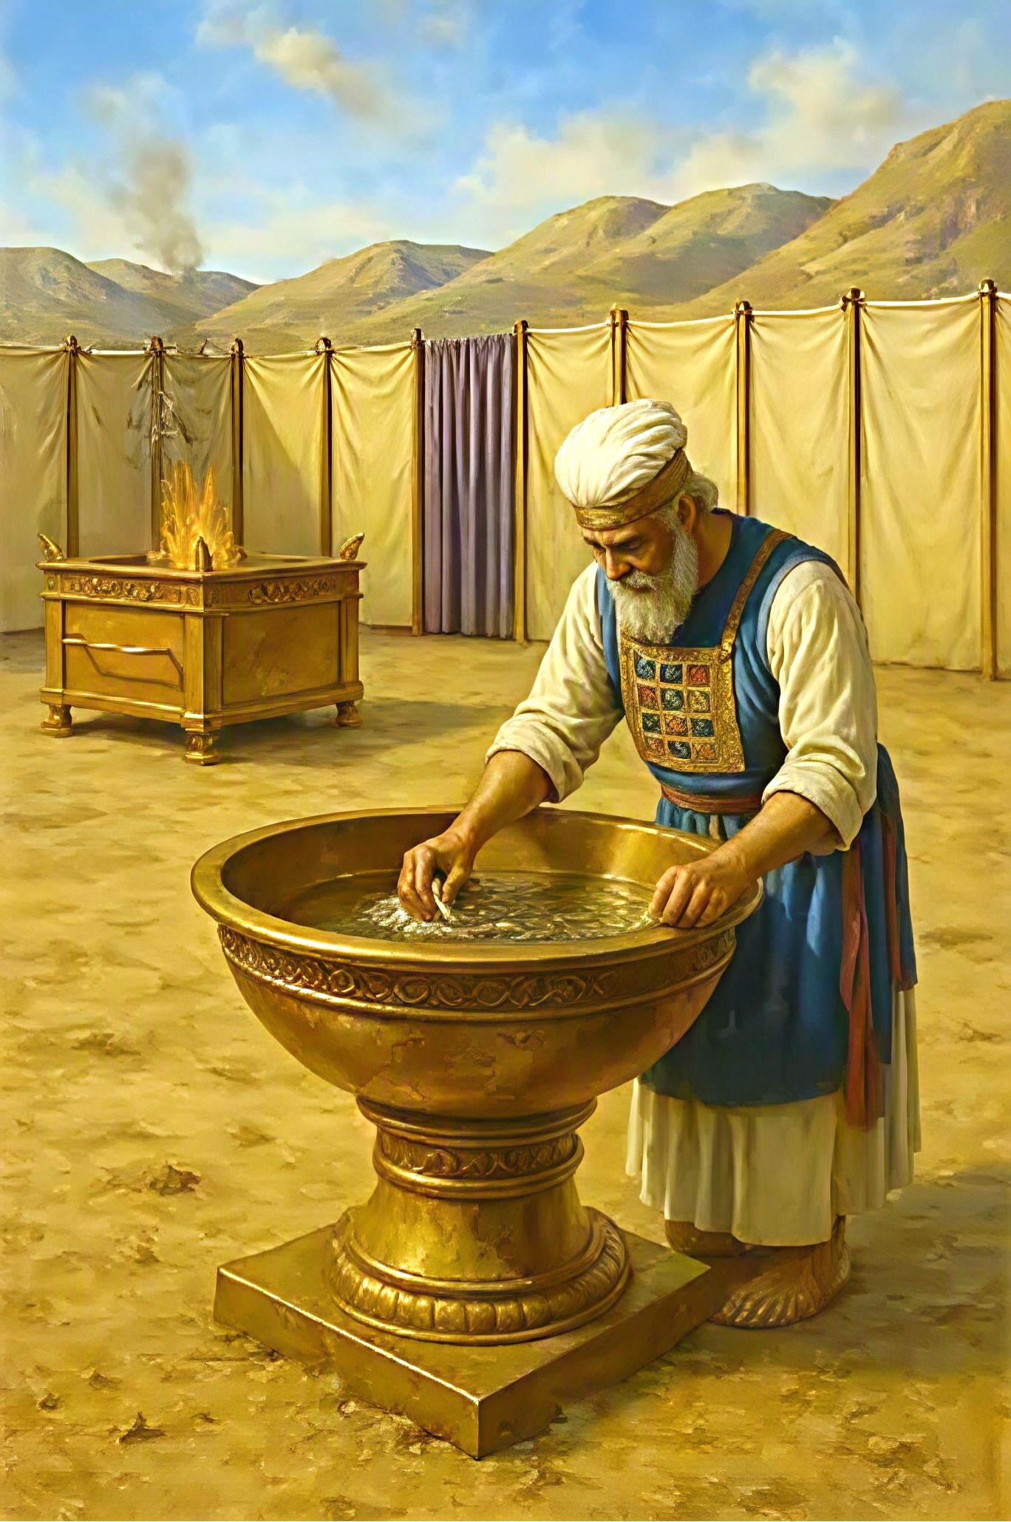
The Laver Ex 30.17-21
…or copper alloy basin is designed for perpetual surrender where Yahweh is always ready to release blessing. He is willing to remember (Zakar).
This altar was made of the looking glasses of the women (Ex 38.8), highly polished copper plates. The laver was to contain water for washing the priest’ hands and feet in their sacred service.
Copper symbolizes Yah’s judgment-a metal able to withstand intense heat for prolonged periods
The purpose of the mirror is for the “Bride” to prepare herself to meet her Bridegroom. Therefore, the laver would be a place of separation and cleansing from worldly things.
Notes:
Atomic Structure: Copper contains a dense lattice of positively charged ions surrounded by a "sea" of free, delocalized electrons.
Rapid Transfer: When you touch copper, these free electrons rapidly absorb thermal energy from your skin and distribute it throughout the metal via quick molecular collisions.
The "Cool" Sensation: Because copper pulls heat away from your body much faster than materials like wood, fabric, or plastic, it instantly drops the skin temperature at the point of contact, making the metal feel intensely cold to the touch even if it is at room temperature.

Slide 14
The Laver
Ex 30.17-21
Yahweh is not ONLY interested in forgiveness for our sins, but also our daily cleanliness in living for Him. Romans 12.2, 2 Corinthians 3.18
If the laver was first and the altar second, it would convey that Messiah’s gospel says to live clean then Yah will forgive.
He gives power through Ruach for one to live clean.
Yeshua looks into us with the express purpose of seeing His own perfect image. “Be holy for I Am holy” 1Pe 1.16
We are to look at the Altar and identify with the slain sacrifice (in its fullness), then go to the laver for further cleansing (water). We don’t want to rush into service and bypass the necessary preparation.

Slide 15
The Laver
Ex 30.17-21
At this laver, we come for cleansing from daily defilement. Ps 119.9, Jn 15.3;17.17, Eph 5.26
We are to render continual service which requires continued cleansing.
While Yahweh provided exact measurements for every piece of furniture in the Tabernacle, He did not for the Laver – the Laver had no limitations or dimensions.
Jn 13.6-10a If a person is born again, he has been cleansed by Yeshua’s blood, he does not need cleansing again, he needs to have only his feet washed. Cleansed by the word.

Slide 16
The Laver
The laver speaks to those who have been crucified at the Altar.
To those who are being separated from the world, sanctification and holiness. Matt 4.4
It does not send forth royal priest carrying all the paraphernalia and trappings of the world into service unto Yahweh. Ro 8.13 “…you will live.” verses Ex 30.21 lest they die as in Gan-Eden.
It does not send the priest carrying his own mirror of self-esteem, loaded with every worldly trick whereas, his feet still walking the old nature.
Repentance at the Altar calls for changed ways (2 Co 6.17) No one who is saved returns to the same sin and supposedly serves Messiah.

Slide 17
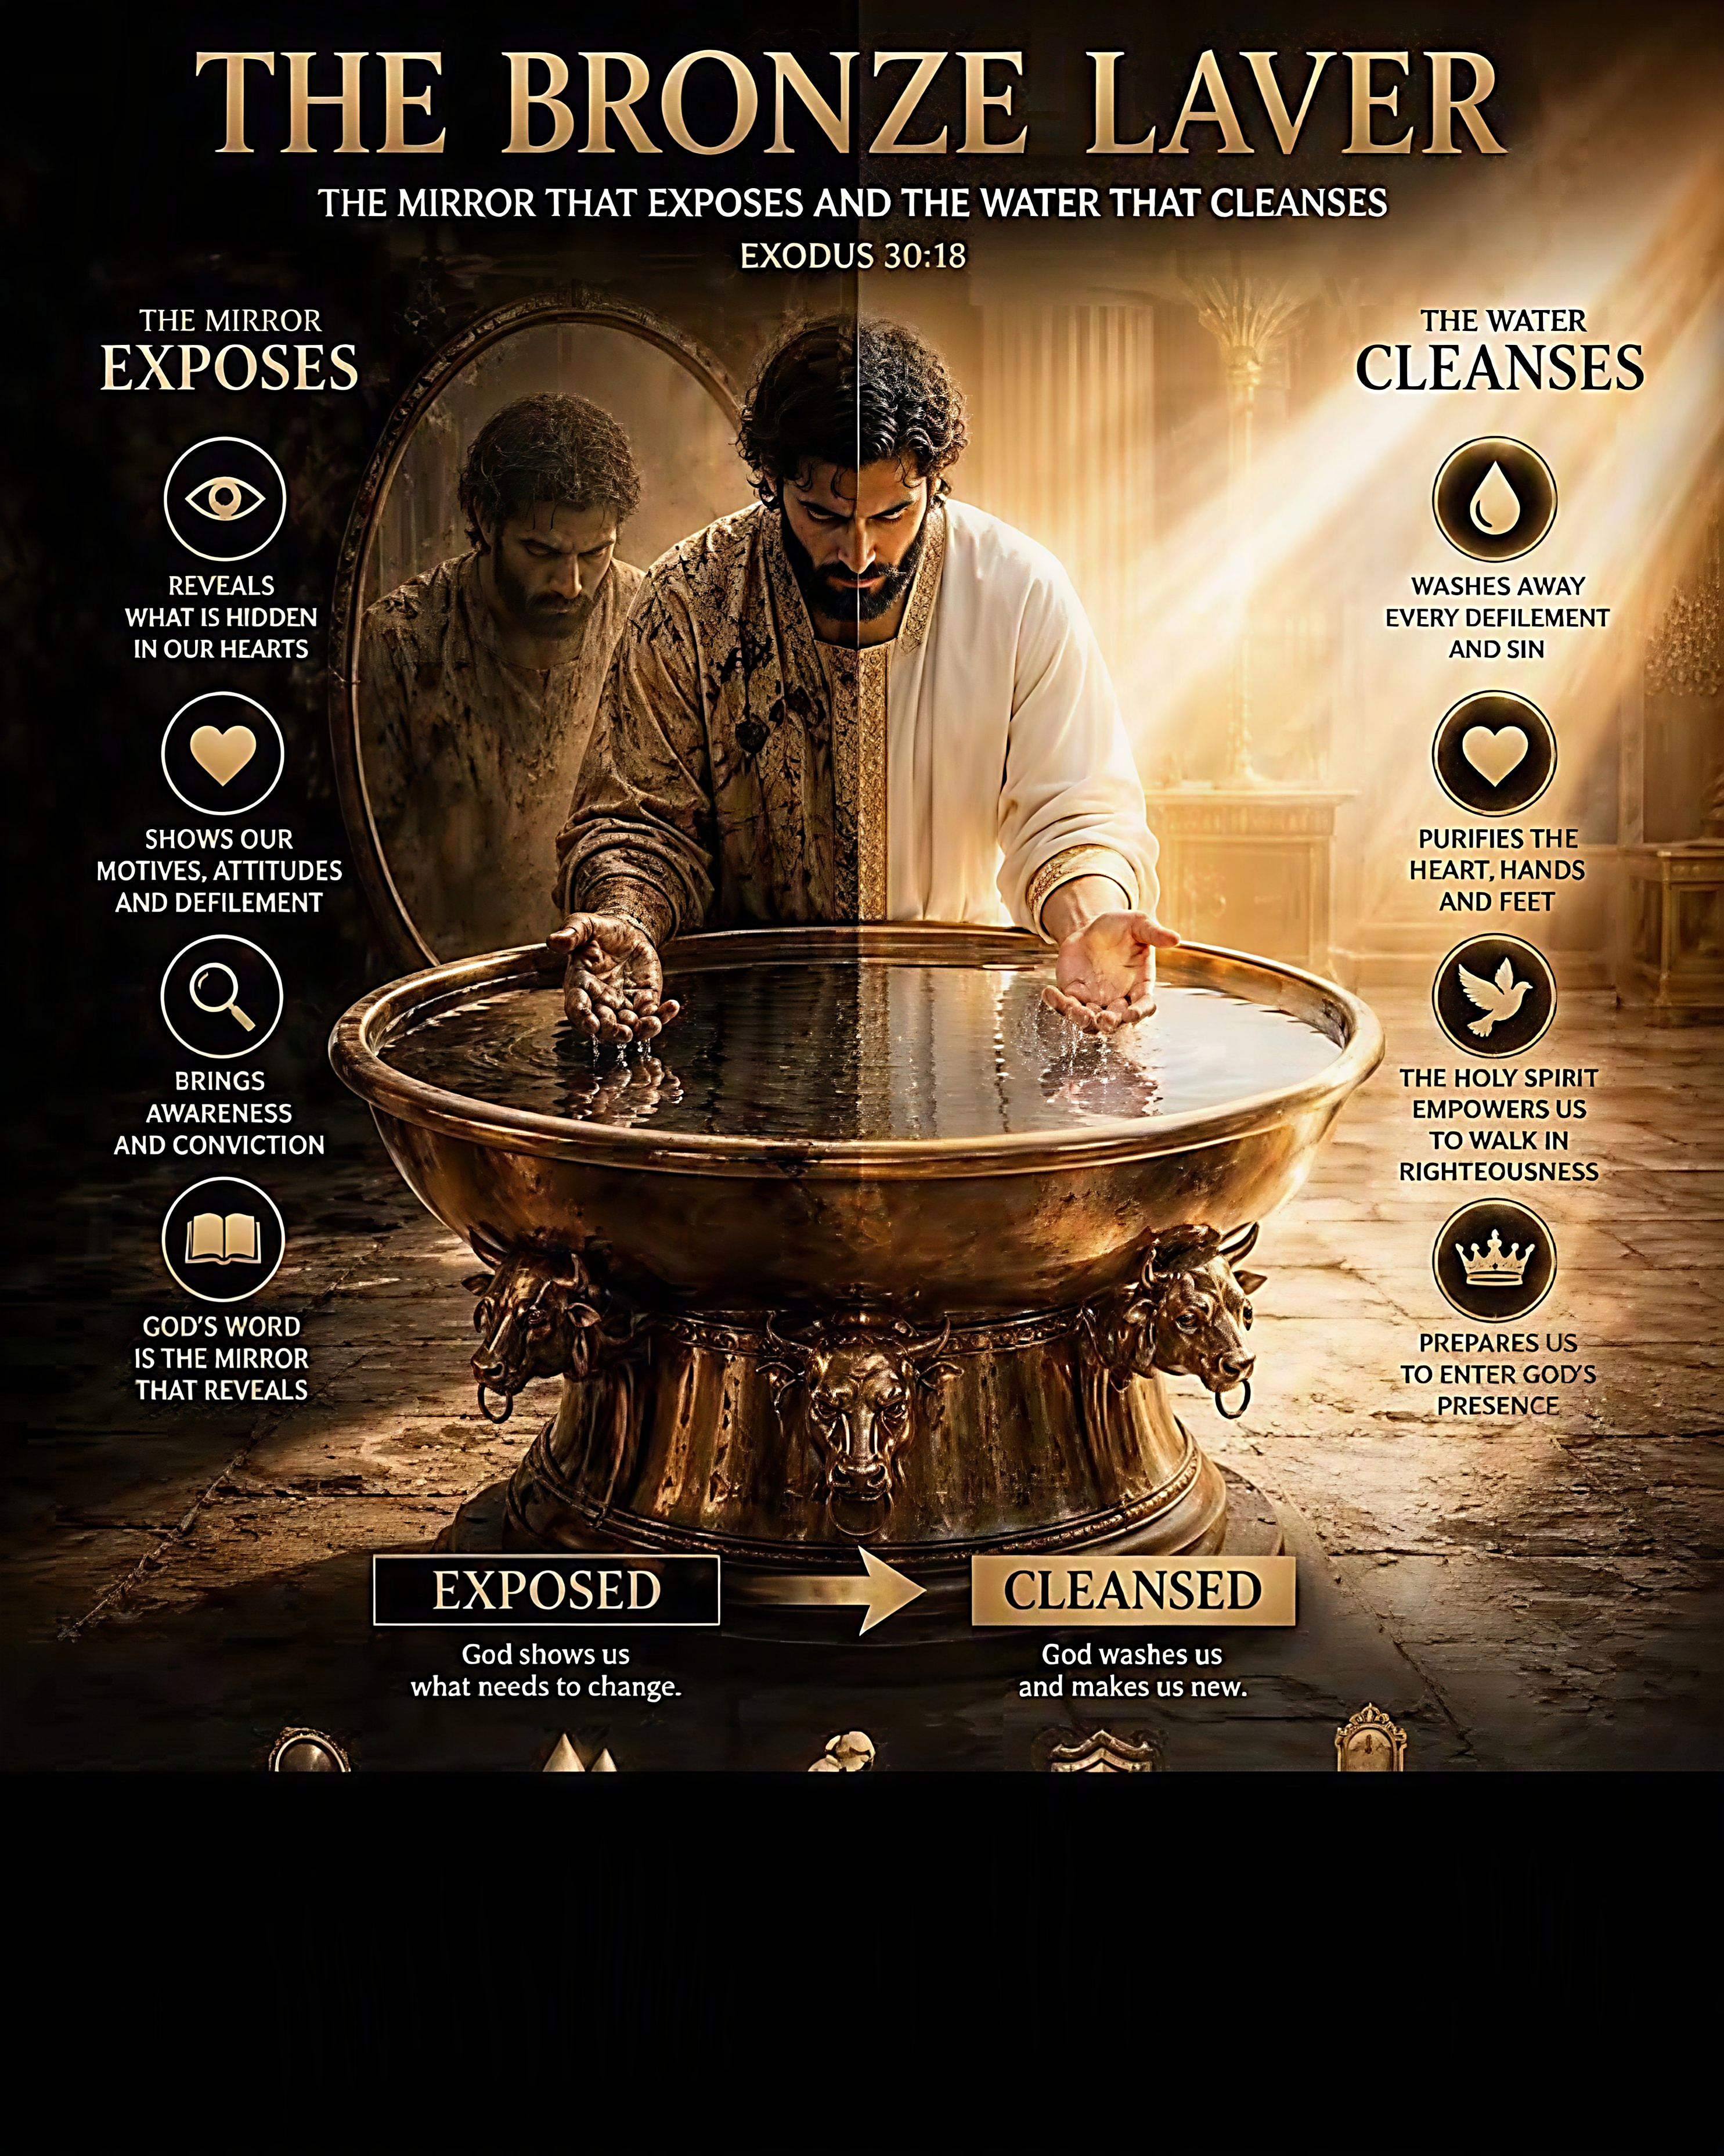
The Laver and its cleansing by the Word of Yah, is essential.
The Corinthian community was sanctified, cleansed, forgiven by Yah and made a dwelling for Him, but then strayed from the Laver. 1Co 6
Because they failed to visit the Laver and look into the mirror of Yahweh’s word, they fell into sin and distanced themselves from Yah’s presence.
Daily communion with Yah’s word without contaminating it with your own limited view is crucial to healthy growth and right relationship with Yah.

Slide 18
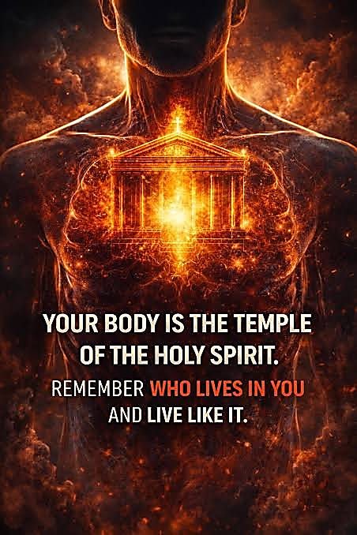
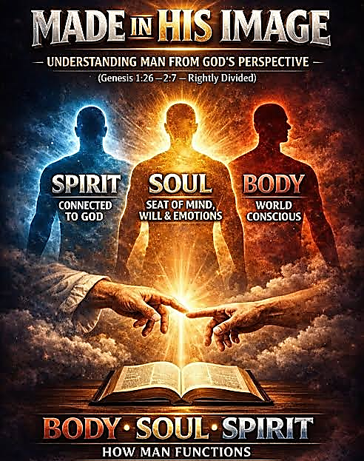
The Bible Narrative is all about Yahweh creating humankind and sharing His own life with us; how He sustains human life and how we are to sustain His image on earth.
As we journey through the Tabernacle, we can prepare ourselves for Yeshua’s return being cleansed and sanctified as a Bride whom the Ruach dwells with.

Slide 19
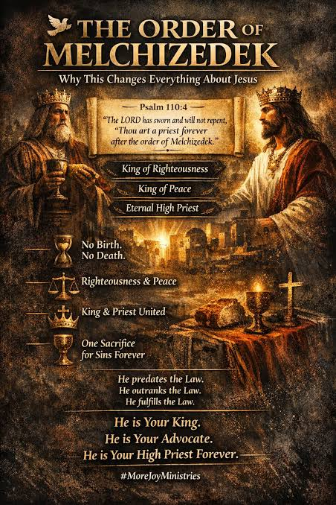
Decree & Declare
Heb 7.14-17; 25 Psalm 110.4
Lord Yeshua, You are our eternal High Priest. Yahweh’s oath settles it! You minister to us in the power of an endless life. So, we come boldly into the Father’s presence, knowing we will not be denied.

